Slide 1


Welcome Future Graduate!
Florida Vocational Institute’s New Student Orientation

Slide 2

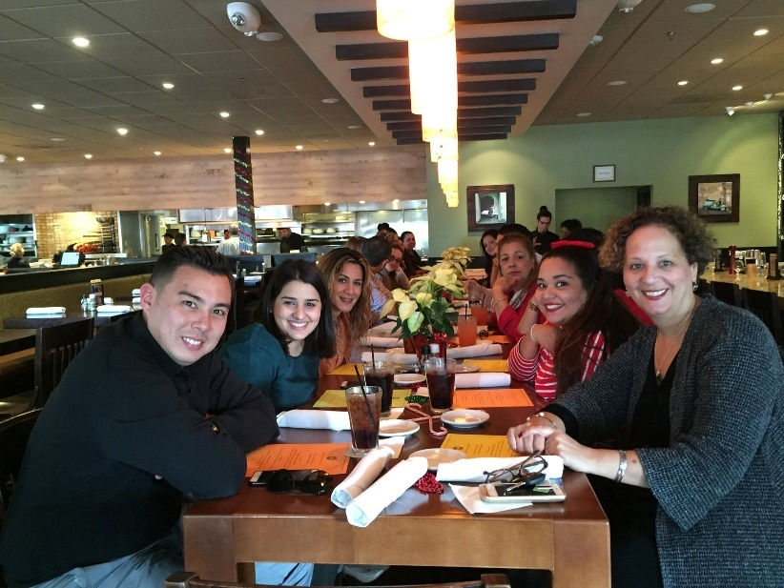
Agenda
New Student Orientation
1
Meet the FVI Team
2
What Are Your Goals
3
Program Overview
4
Classroom Expectations / Standards of Conduct
5
Prep Hour Expectations
6
Substance Abuse / Drug Screening
7
Applying for work and certifications

Slide 3

Meet the FVI Team
Administration
Campus Vice President-Denyse Antunes
Faculty/ Program Director – Marta Marerro
Student Support Team
Director of Admissions - Chris Kapalka
Business Office Manager – Luisa Enriquez
Financial Aid Administrator- Eliezer Tabares
Registrar- Lidia Bravo
Director of Career Services- Andrea Holguin-Reyes
Helping Students Achieve Success

Slide 4


Agenda
New Student Orientation
1
Meet the FVI Team
2
What Are Your Goals
3
Program Overview
4
Classroom Expectations / Standards of Conduct
5
Prep Hour Expectations
6
Substance Abuse / Drug Screening
7
Applying for work and certifications

Slide 5










What Are Your Goals
1
2
3
4
5
Practice, practice, practice
Develop skills and expertise
Career U-U-U
Complete
Courses
SUCCESS!!
6
Begin your Career as a developer or IT Professional and
start living the life you always wanted!
Helping Students Achieve Success

Slide 6


Agenda
New Student Orientation
1
Meet The FVI Team
2
What Are Your Goals
3
Program Overview
4
Classroom Expectations / Standards of Conduct
5
Prep Hour Expectations
6
Substance Abuse / Drug Screening
7
Applying for work and certifications
Helping Students Achieve Success

Slide 7
Program Overview
Program and Course Description (School Catalog)
Program Mission and Outcomes
Grading Policy (School Catalog)
Attendance Policy (School Catalog)
Student Conduct/Expectations (School Catalog)
Grievance Procedure (School Catalog)

Slide 8

Agenda
New Student Orientation
1
Meet the FVI Team
2
What Are Your Goals
3
Program Overview
4
Classroom Expectations / Standards of Conduct
5
Prep Hour Expectations
6
Substance Abuse / Drug Screening
7
Applying for work and certifications

Slide 9

Classroom Expectations / Standards of Conduct
Attend classes every day
Prepare for class and arrive on time
Prep hour completion is essential to success.
Suggested prep hours are a minimum, more practice is always better
No food in classrooms. Drinks with a lid are permitted.
Respectful behavior, and all electronic devices should be turn off.
Obligation to act as responsible members of the FVI community
Behavior that discredits student or the School may lead to disciplinary action, suspension, and/or dismissal.
Helping Students Achieve Success

Slide 10


Agenda
New Student Orientation
1
Meet the FVI Team
2
What Are Your Goals
3
Program Overview
4
Classroom Expectations / Standards of Conduct
5
Prep Hour Expectations
6
Substance Abuse / Drug Screening
7
Applying for work and certifications

Slide 11
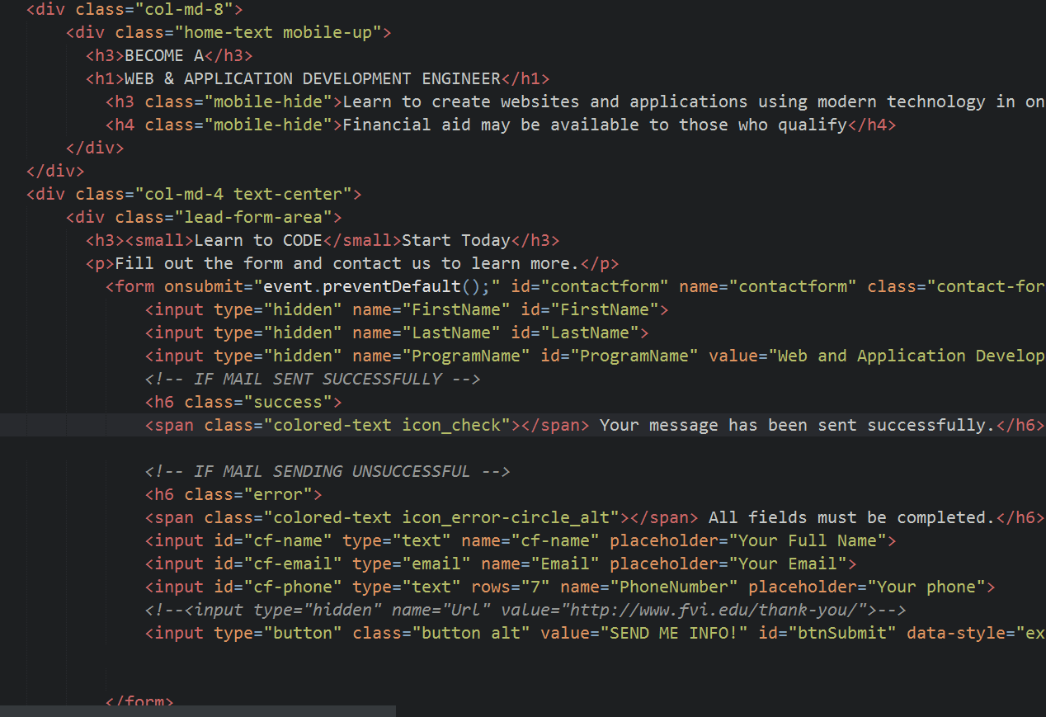
Prep Hour Expectations
Prep Hours (homework hours) are assigned at the beginning of each three-week term
Due date is the last day of the term
20% of the final grade of each class is derived from prep hour work
On average, time commitment of 5 hours per week is expected
Helping Students Achieve Success

Slide 12


Agenda
New Student Orientation
1
Meet the FVI Team
2
What Are Your Goals
3
Program Overview
4
Classroom Expectations / Standards of Conduct
5
Prep Hour Expectations
6
Substance Abuse / Drug Screening
7
Applying for work and certifications

Slide 13

Substance Abuse / Drug Screening
Drug and Alcohol Policy ( School Catalog )
May be requested with evidence of behavioral indicates of prohibited substance use.
Will lead to immediate action
We are a drug free school in order to prepare you for the labor force, where many workplaces are drug free
Helping Students Achieve Success

Slide 14




Agenda
New Student Orientation
1
Meet the FVI Team
2
What Are Your Goals
3
Program Overview
4
Classroom Expectations / Standards of Conduct
5
Prep Hour Expectations
6
Substance Abuse / Drug Screening
7
Applying for work and certifications

Slide 15

Applying for work and certifications
Only the IT Cloud and Security program has certifications
Network+ and Security+ are absolutely essential to student success
The qualifications for the Web development program are conveyed in the student portfolio
Entry into the field is assessment-based. Companies will give you tests and if you cannot pass you will not get hired.
Helping Student Achieve Success

Slide 16
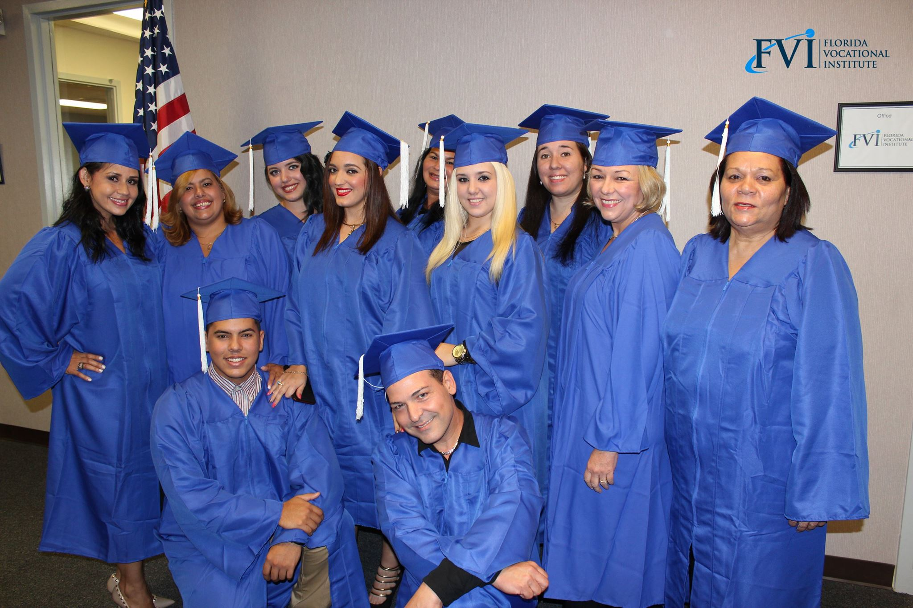
Your Journey Starts Now!

